Slide 1

WEYLAND ENERGY
Budget 2026
Supervisory Board · 11 December 2025

Slide 2
Budget 2026 at a glance
EUR 334 m
EUR 156 m
46.7 %
EUR 640 m
revenue (+7 %)
EBITDA
EBITDA margin
capex
WEYLAND ENERGY · Budget 2026
2

Slide 3
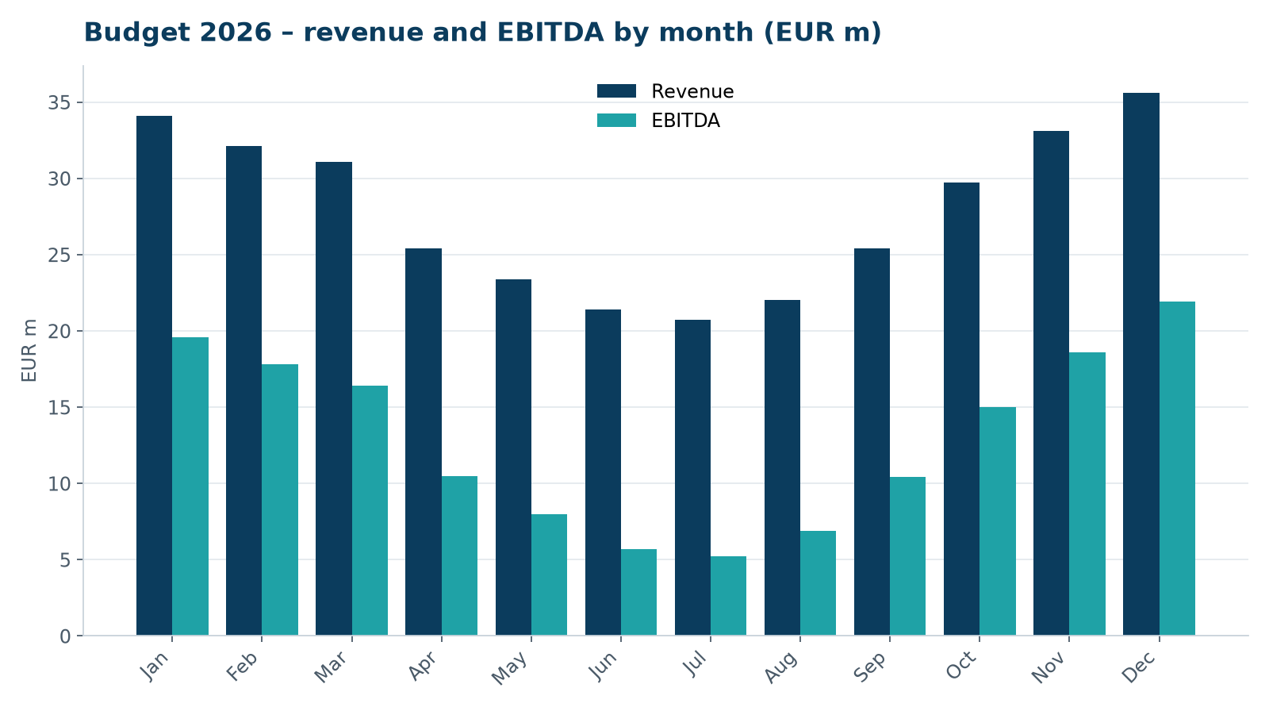
Revenue by month
• Strong seasonality: Q1 and Q4 wind months
• Q3 is the weakest quarter
• P50 generation assumed
WEYLAND ENERGY · Budget 2026
3

Slide 4
Bridge 2025 → 2026
EBITDA bridge | EUR m
EBITDA 2025 | 148.0
Full year of Kestrel Ridge availability bonus | +2.1
Battery trading | +3.4
Price effects (net of hedges) | +4.6
Personnel (+18 FTE, 3.5 % salary increase) | -4.9
IT / ISO 27001 programme | -0.8
Other | +3.6
EBITDA budget 2026 | 156.0
WEYLAND ENERGY · Budget 2026
4

Slide 5
Capex 2026
• Harrow Bay: EUR 590 m (turbine and foundation milestones, MV Sea Atlas)
• Fleet maintenance capex: EUR 17.5 m
• Development (Millbrook, Fenwick): EUR 4.1 m
• IT: EUR 2.7 m
WEYLAND ENERGY · Budget 2026
5

Slide 6
Risks
• Wind resource (± 5 % ≈ EUR 9 m revenue)
• Power prices (–10 % ≈ EUR 7 m EBITDA after hedges)
• Harrow Bay financial close in February
WEYLAND ENERGY · Budget 2026
6
Notes:
Gareth will ask about P50 vs P90 – liquidity plan is stress-tested on P90.

Slide 7
WEYLAND ENERGY
Proposed resolution
Approval of the budget 2026

